Slide 1
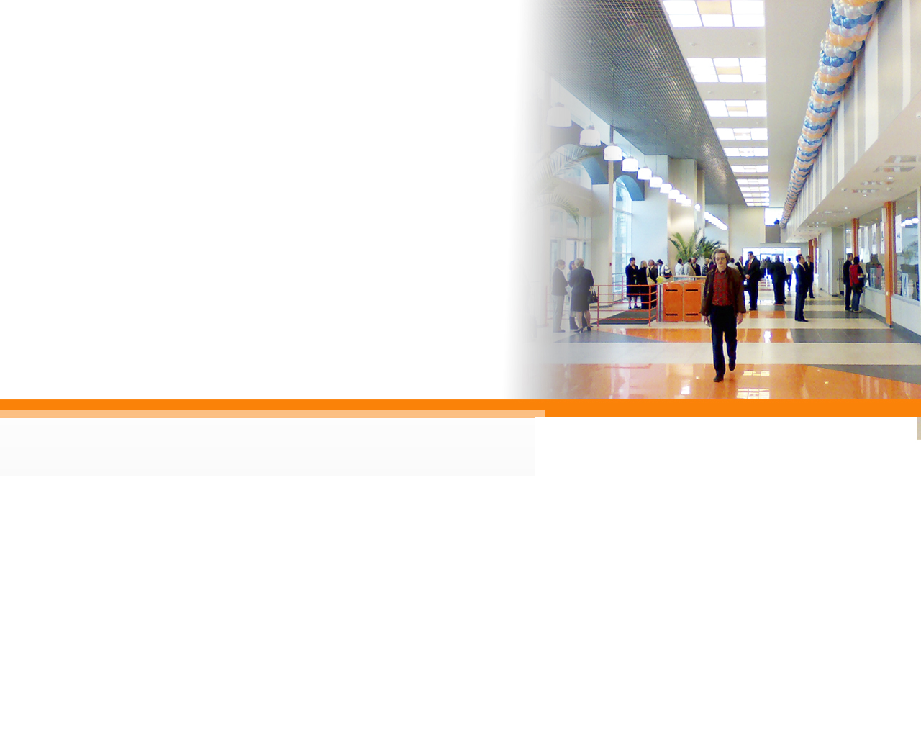

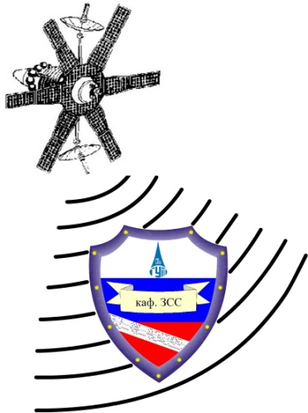


Authentication
Authorization
Session Management
Data Validation
Error Handling
Logging
Encryption
Security Mechanism:
Data Validation

Slide 2

Data Validation Core Concepts
Given that the client can bypass any client-side controls, all data
collected from the client must be considered suspect.
Is the data of a proper length and well formed for what was
expected by the application?
Known Good Exact Match (Whitelisting)
Known Good Characters (Whitelisting)
Known Bad Characters (Blacklisting)
Known Bad Exact Match (Blacklisting)

Slide 3
Data Validation Words to Live By
Validate data before use in SQL Commands
Validate data before sending back to the client
Validate data before use in ‘eval’ or system commands
Validate all data lengths before writing to buffers
Notes:
There are four words to live by for Data Validation. These align to the four big vulnerabilities that we see today: SQL injection, cross-site scripting, command injection, and buffer overflows.

Slide 4
Data Validation Words to Live By: #1
Validate data before use in SQL Commands
CWE-89 : Improper Neutralization of Special Elements used in an SQL Command (‘SQL Injection’)
  The software constructs all or part of an SQL command using externally-influenced input from an upstream component, but it does not neutralize or incorrectly neutralizes special elements that could modify the intended SQL command when it is sent to a downstream component.

Slide 5
1 string strUser = request.getParameter("user");
2 string strPwd = request.getParameter("password");
3
4 string strQuery = "SELECT * FROM users
5 WHERE username = '" + strUser + "'
6 AND password = '" + strPwd + "'";
7
8 ExecuteQuery( strQuery, db_connection );
Adam'--
SELECT * FROM users WHERE username = 'Adam'--' AND password = ''

Slide 6
1 string strUser = request.getParameter("user");
2 string strPwd = request.getParameter("password");
3
4 string strQuery = "SELECT * FROM users
5 WHERE username = '" + strUser + "'
6 AND password = '" + strPwd + "'";
7
8 ExecuteQuery( strQuery, db_connection );
a' OR 1=1--
SELECT * FROM items WHERE username = 'a' OR 1=1--' AND password = ''

Slide 7
1 string strUser = request.getParameter("user");
2 string strPwd = request.getParameter("password");
3
4 string strQuery = "SELECT * FROM users
5 WHERE username = '" + strUser + "'
6 AND password = '" + strPwd + "'";
7
8 ExecuteQuery( strQuery, db_connection );
a'; DELETE FROM username; SELECT * FROM items WHERE 'a'='a
SELECT * FROM username WHERE user = 'a';
DELETE FROM username;
SELECT * FROM username WHERE 'a'='a' AND password = ''

Slide 8
1 string strUser = request.getParameter("user");
2 string strPwd = request.getParameter("password");
3
4 string strQuery = "SELECT * FROM users
5 WHERE username = '" + strUser + "'
6 AND password = '" + strPwd + "'";
7
8 ExecuteQuery( strQuery, db_connection );
'; EXEC master..xp_cmdshell 'dir' --
SELECT * FROM username WHERE user = '';
EXEC master..xp_cmdshell 'dir' --' AND password = ''

Slide 9
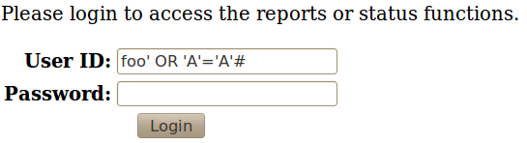
SQL Injection – Exploit Demo
What just happened?
Make an example for UNION BASED SQL Injection
Notes:
Demo a very simple SQL Injection vector via the login page. The attack will inject the userid field, causing the SQL statement to return all users from the user table back to the command. The program just reads the first line returned from the DB, not checking if there was more than one match, and assumes the user must have logged in successfully (user & password provided must have matched).
Explain that this is an extremely simple case to illustrate the coding weakness. There are much more sophisticated versions of this attack, leveraging UNION statements to map table structure and return additional information as well as Blind SQL Injection to return information from the DB even when the query might never normally return any data to the client.

Slide 10
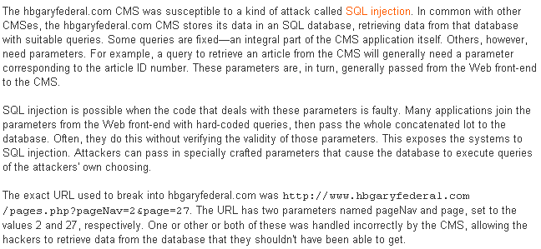
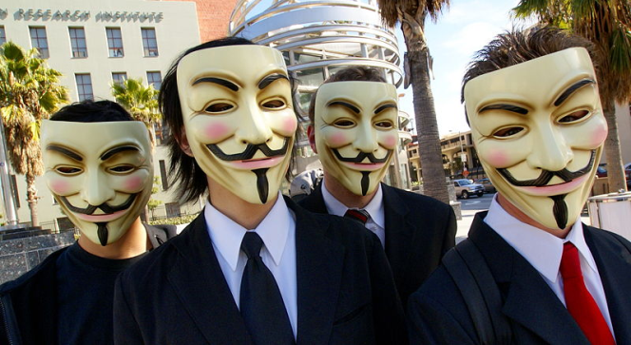
Real World – HBGary Federal vs. Anonymous
Notes:
Note that even a very basic validation ensuring that number was supplied would have worked here. If you look at the two parameters (pageNav and page) both appear to be only numeric.

Slide 11
Secure Coding …
Restrict length (username doesn't need to be 100 chars long)
Whitelist characters (only allow a-z and A-Z for username)
Use prepared statements
1 string strUser = request.getParameter("user");
2 if(strUser.length > 100) error();
3 if(strUser.matches("^[a-zA-Z]+$") == false) error();
4
5 string strQuery = "SELECT * FROM users
6 WHERE username = ?
7 AND password = ?";
8
9 PreparedStatement stmnt = null;
10 stmnt = db_connection.prepareStatment(strQuery);
11 stmnt.setString(1,strUser);
12 stmnt.setString(2,strPwd);
13 stmnt.execute();
Notes:
To properly protect our code from SQL injection, we should take a defense-in-depth approach. First, we should perform some basic validation related to the type of information we expect. In this case we are working with a username. It is probably safe to assume that a username should be less than 100 characters long, so we should verify that input conforms to this. Next we should use a whitelist if possible to restrict the input to a set of valid characters. For most of us, all our usernames are just characters so maybe it is correct to only allow characters in our input string. Finally, we should use prepared statements instead of directly concatenating the input with the SQL query. Using prepared statements automatically enforces that a data field will be just a data field and will not allow an attacker to single-tic their way out of the field and inject additional commands.
Note that escaping the single tic would be a start, but this might not be enough. This is in a form of blacklisting where we try to exclude certain characters. The problem is that different character encodings may be possible that could pass the blacklist but still be interpreted as a single tic. For example, x027 is the hex value for the single tic.

Slide 12
Data Validation Words to Live By: #2
Validate data before sending back to the client
CWE-79: Improper Neutralization of Input During Web Page Generation (‘Cross-site Scripting’)
  The software does not neutralize or incorrectly neutralizes user-controllable input before it is placed in output that is used as a web page that is served to other users.

Slide 13
XSS Flow
server
4
1
attacker's code sent
to user and run in
their browser
Persistent XSS
  create malicious site
  malicious post
Reflected XSS
  vulnerable site
3
- browse to site
- clicks on link
- wait for user to visit site
- send phishing email
Attacker
2
User
Notes:
Persistent XSS vs. Reflected XSS
Persistent = a malicious site or a malicious post, get user to visit the site
Reflected = find a vulnerable site that "reflects back" the values in the URL, send the code as part of the phishing URL and get the user to click the link, the "trusted" server reflects back the code that is then rendered/run in the user's browser.

Slide 14
1 <% string strLabel = request.getParameter("label"); %>
2
3 <P>
4 Label: <%= strLabel %>
5 </P>
<SCRIPT SRC=http://hacker.org/malicious.js />
<P>
Label: <SCRIPT SRC=http://hacker.org/malicious.js />
</P>

Slide 15
1 <% string strLabel = request.getParameter("label"); %>
2
3 <P>
4 Label: <%= strLabel %>
5 </P>
<IMG SRC=javascript:alert('XSS')/>
<P>
Label: <IMG SRC=javascript:alert('XSS') />
</P>

Slide 16

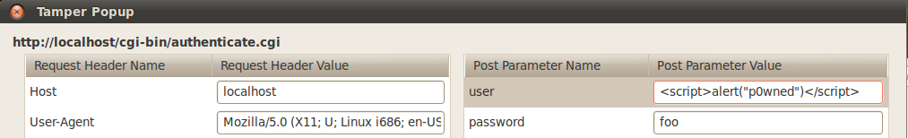
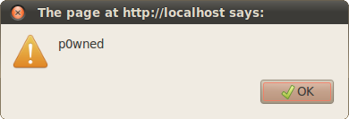
XSS Injection – Exploit Demo
Actual usage by a threat actor will not be this obvious…
Notes:
Demo a simple XSS attack. This can either be done directly from the login page userid field or can be done leveraging the Tamper Data interface. Pop a simple alert window to demonstrate how the data provided as input is being interpreted by the browser as code from the server.
Discuss how the actual attack will be much worse in reality. Low-end hacktivists & script kiddies might settle for apparent site defacement or misleading data being provided on the page. Cyber criminals can use the attack to provide misleading information (bogus AV software alerts for example). Some cyber criminals and advanced threats may leverage this weakness to steal/harvest session identifiers for your site or to cause a cross-site request forgery (CSRF).

Slide 17
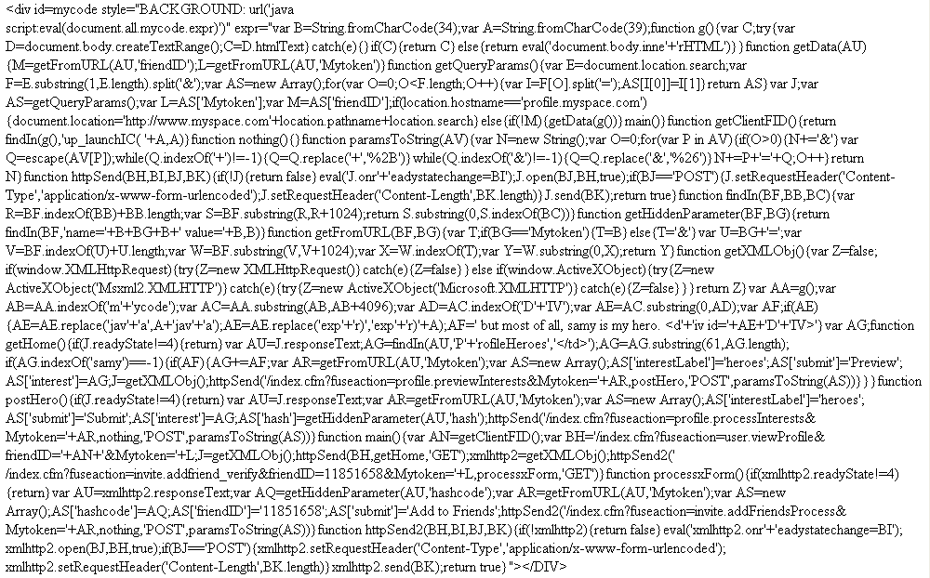
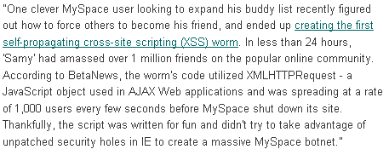
Real World – Myspace & samy is my hero
1 hour: 1 new friend
8 hours: 222 new friends
13 hours: 8803 new friends
18 hours: 1,005,831 new friends

Slide 18
Secure Coding …
Validate input (only accept characters that make sense)
Encode output (escape characters like "<")
  HTML encode
  URL encode
  JavaScript encode
1 <%
2 string strLabel = request.getParameter("label");
3 if(strLabel.matches("^[a-zA-Z0-9]+$") == false) error();
4 %>
5
6 <P>
7 Label: <%= encodeHTML(strLabel) %>
8 </P>

Slide 19
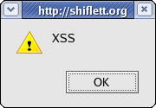
Real World – Google's URL Redirection
In 2005, Watchfire reported the following XSS issue with Google …
The script http://www.google.com/url?q= was used for redirecting the browser from Google's website to other sites. When the parameter q was passed to the script in an illegal format, a "403 Forbidden" page was returned to the user, informing them that the query was illegal. The parameter's value appeared in the html returned to the user.
For example, if http://www.google.com/url?q=EVIL_INPUT was requested, the text in the "403 Forbidden" response would have been: - "Your client does not have permission to get URL /url?q=EVIL_INPUT from this server."
While Google escaped common characters used for XSS, such angle brackets and apostrophes, it failed to handle hazardous UTF-7 encoded payloads. Therefore, when sending an XSS attack payload encoded in UTF-7, the payload would return in the response without being altered.
  <?php
    header('Content-Type: text/html; charset=UTF-7');
    $string = "<script>alert('XSS');</script>";
    $string = mb_convert_encoding($string, 'UTF-7');
    echo htmlentities($string, ENT_QUOTES, 'UTF-8‘
  ?>
Notes:
A XSS vulnerabilities was identified in the Google.com website, which allowed an attacker to mount a phishing attack. Although Google uses common XSS countermeasures, a successful attack is possible, when using UTF-7 encoded payloads.
The script (http://www.google.com/url?q=...) is normally used for redirecting the browser from Google's website to other sites. When requesting a page which doesn't exist under www.google.com, a 404 NOT FOUND response is returned to the user, with the original path requested. While the aforementioned mechanisms (URL redirection script, 404 NOT FOUND) escape common characters used for XSS, such as <> (triangular parenthesis) and apostrophes, it fails to handle hazardous UTF-7 encoded payloads.
The server response lacks charset encoding enforcement, such as: Response headers: "Content-Type: text/html; charset=[encoding]". Therefore, when sending an XSS attack payload, encoded in UTF-7, the payload will return in the response without being altered.
If "Encoding" is set to "Auto-Select", and Internet-Explorer finds a UTF-7 string in the first 4096 characters of the response's body, it will set the charset encoding to UTF-7 automatically, unless a certain charset encoding is already enforced.
UTF-7 allows multiple representations of the same source string. In particular ASCII characters can be represented as part of Unicode blocks. As such if standard ASCII based escaping or validation processes are used on UTF-7 then Unicode blocks may be used to slip malicious strings past them.
Older versions of Internet Explorer can be tricked into interpreting the page as UTF-7. This can be used for a cross-site scripting attack as the < and > marks can be encoded as +ADw- and +AD4- in UTF-7, which most validators let through as simple text.
The sample PHP code show how this works. The sample page defines the content type as UTF-7 and then creates a UTF-7 string that contains the payload. HTML encoding is then performed to remove XSS specific characters, but the encoding is done on UTF-8 characters. The end results is that the string is not properly encoded and the payload is delivered to the user's browser. The browser see the UTF-7 content type and renders the page accordingly, enabling the attack.

Slide 20
Data Validation Words to Live By: #3
Validate data before use in ‘eval’ or system commands
CWE-95: Improper Neutralization of Directives in Dynamically Evaluated Code (‘Eval Injection’)
  The software receives input from an upstream component, but it does not neutralize or incorrectly neutralizes code syntax before using the input in a dynamic evaluation call (e.g. "eval").

Slide 21
1 my $options = readSocket($sock);
2 my $command = "/bin/ls " . $options;
3 system($command);
-lad
/bin/ls -lad

Slide 22
1 my $options = readSocket($sock);
2 my $command = "/bin/ls " . $options;
3 system($command);
-lad; rm -rf *;
/bin/ls -lad; rm -rf *;

Slide 23


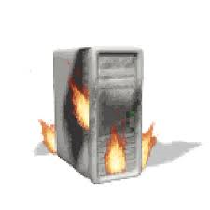
Eval Injection – Exploit Demo
Becoming a persistent threat:
Discovery of the eval injection
Delivery of a crafted payload to make exploit and future exploits easier
We own the server
cat authenticate.cgi
cat /etc/apache2/modules/DBAuth.pm
Delivery of new crafted payload for dumping database information
  SELECT * FROM users
  SELECT * FROM reports
We own the database
All your data are belong to us.
Fuzzing
Notes:
Demo – Show looking at the status functionality in the site. Show an attempt to ‘fuzz’ the ‘check’ name/value pair using TamperData. Use a string like ‘”<>;:%. The error message returned gives the hint that this is an eval statement that caused the error. Mention that at this point it’s just trial and error until you perfect your payload. Cut & paste over a prepared malicious payload from the eval-attack.txt file. The first one is f.cgi which will allow command execution via the “c” name/value pair. The second is d.cgi which also uses the “c” name/value pair to execute DB commands in the application database. Using the f.cgi, you can do a ls –l, show finding the authenticate.cgi source, then using that to identify the file that the DB connection information is coming from along with the ID & password. Then upload the 2nd file to take advantage of that to gain full access to the DB.

Slide 24
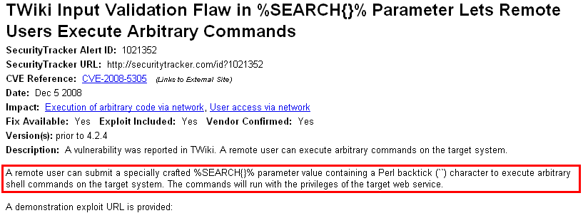
Real World Example – TWiki Exploit
CVE-2008-5305 – The search parameter of the website was being placed into an eval function, allowing remote users to fully exploit the server
http://example.org/twiki/bin/view/Main/WebSearch?search=%25SEARCH%7Bdate%3D%22P%60pr+-%3F%60%22+search%3D%22xyzzy%22%7D%25&scope=all
Notes:
Perl backtick runs a command and returns the command's output (stdout). For example … print `perl -le "print -t STDOUT"`… This prints the output of the command … perl -le "print -t STDOUT" … This is very similar to the perl system() function, however system() returns a status code, not stdout.
From http://twiki.org/cgi-bin/view/Codev/SecurityAlert-CVE-2008-5305 …
The %SEARCH{}% TWiki variable or a specially crafted GET URL enables a malicious user to compose a command line executed by the Perl backtick (``) operator. User input is passed to the perl "eval" command without first being sanitized.
If access to TWiki is not restricted by other means, attackers can use the SEARCH variable with or without prior authentication, depending on the configuration.
Proof of concept:
Enter the following in the search box:
%SEARCH{ date="P`pr -?`" search="xyzzy" }%
Or use a GET URL like:
http://example.org/twiki/bin/view/Main/WebSearch?search=%25SEARCH%7Bdate%3D%22P%60pr+-%3F%60%22+search%3D%22xyzzy%22%7D%25&scope=all
Afterwards, evidence of command execution can be seen in the webserver's error_log:
[Thu Sep 11 22:13:36 2008] [error] [client 127.0.0.1] pr: invalid option -- ?
[Thu Sep 11 22:13:36 2008] [error] [client 127.0.0.1] Try `pr --help' for more information.

Slide 25
Secure Coding …
Restrict length (option doesn't need to be 100 chars long)
Whitelist (only allow specific commands)
1 my $options = <STDIN>;
2 if length($options) > 100
3 {
4 error();
5 }
6 if ($options =~ m/^[a-zA-Z\- ]+$/)
7 {
8 my $command = "/bin/ls " . $options;
9 system($command);
10 }

Slide 26
Data Validation Words to Live By: #4
Validate all data lengths before writing to buffers
CWE-120: Buffer Copy without Checking Size of Input (‘Classic Buffer Overflow’)
  The program copies an input buffer to an output buffer without verifying that the size of the input buffer is less than the size of the output buffer, leading to a buffer overflow.

Slide 27
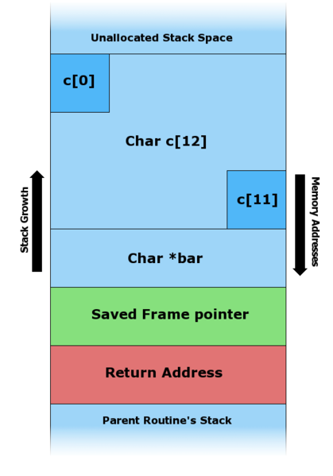
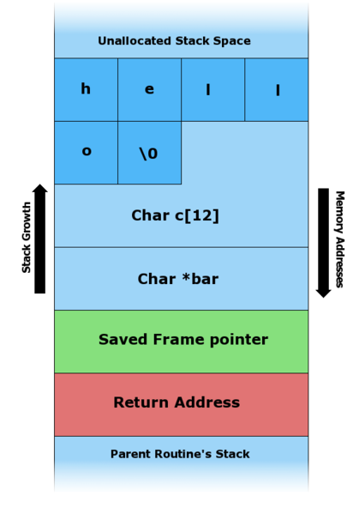
1 char c[12];
2 char *bar;
3 printf("Please enter your name and press <Enter>\n");
4 get bar;
5 strcpy(c, bar);
Hello

Slide 28
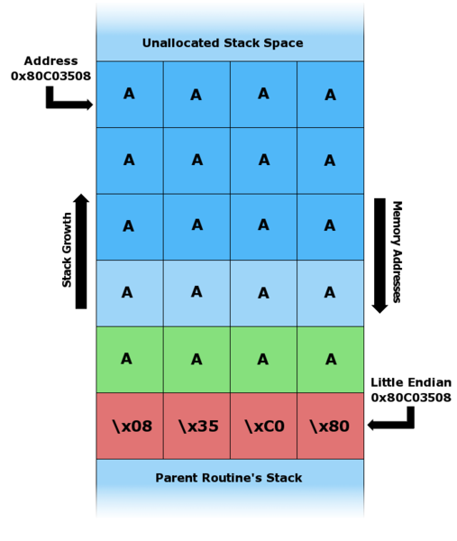
1 char c[12];
2 char *bar;
3 printf("Please enter your name and press <Enter>\n");
4 get bar;
5 strcpy(c, bar);
A​A​A​A​A​A​A​A​A​A​A​A​A​A​A​A​A​A​A​A\x08\x35\xC0\x80

Slide 29
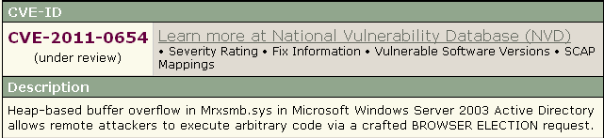
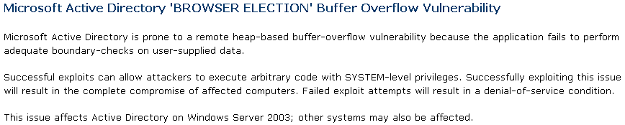

Real World Example – Buffer Overflow
Notes:
Issues in old code still being discovered. Released announcement on Full Disclosure mailing list on 2/14/11, about a new zero-day in Windows Server 2003 and XP SP3.

Slide 30
Secure Coding …
Use "safe" functions (e.g., strncpy() )
Validate maximum and minimum size values
Verify that calculations result in valid ranges
Validate length of input strings (plus NULL terminator!)
Consider compiler switches that reduce danger of buffer overflows
Whitelist when possible
Assume all input is malicious.

Slide 31
Authentication
Authorization
Session Management
Data Validation
Error Handling
Logging
Encryption
Security Mechanism:
Error Handling

Slide 32
Error Handling Core Concepts
Expect the unexpected – your data won’t always be what you assume
When you hit an error condition – log, cleanup, and STOP
Think carefully about what you send to the client and how you send it

Slide 33
Error Handling Words to Live By
Don’t disclose information that should remain private
Remember to cleanup completely in an error condition

Slide 34
Error Handling Words to Live By: #1
Don’t disclose information that should remain private
CWE-200: Information Exposure
  An information exposure is the intentional or unintentional disclosure of information to an actor that is not explicitly authorized to have access to that information.
Think OPSEC!

Slide 35



Information Leakage Examples
Notes:
These are examples we’ve already seen as we’ve been working through the site. The first provides names & account name combinations, and talks about upcoming changes to the code…why do the users need to see this?
The second example shows a bad userid vs. a bad password. This can be used to harvest possible userid values.
Third example – Just the concept of confirming valid server, files, and db connections to a normal user of an application is rather strange. Users don’t need to know that kind of operational detail, and providing it to users just makes an attacker’s job easier to understand what impact his attacks might be having.
Final example – returning a coding related error message (see also – stack traces in Java & such) to the browser/user.

Slide 36
Real World Example – Information Leak
Server Error in '/' Application.
Invalid object name 'user_acc'.
Description: An unhandled exception occurred during the execution of the current web request. Please review the stack trace for more information about the error and where it originated in the code.
Exception Details: System.Data.SqlClient.SqlException: Invalid object name 'user_acc'.
Source Error:
Line 135: sqlcmd = new SqlCommand("select uid, password from user_acc where uid='" + uidd + "'", hookup);
Line 136: hookup.Open();
Line 137: reader=sqlcmd.ExecuteReader();
Line 138:
Line 139: while (reader.Read())
Source File: c:\inetpub\vhosts\cactusindia.com\httpdocs\Default.aspx.cs Line: 137
Stack Trace:
[SqlException (0x80131904): Invalid object name 'user_acc'.]
…
Version Information: Microsoft .NET Framework Version:2.0.50727.4952; ASP.NET Version:2.0.50727.4955
Notes:
This is an example of a real error page posted on the web from a IIS / MS .NET application. Large amounts of information leakage are shown here. The example shows information about DB table structure (notably the account table), includes a source code snippet which helpfully shows that the site is likely vulnerable to SQL Injection, shows the application as being installed on the C: drive in the default location which will be helpful if successful in attacking the application, and includes version numbers of the server install of the .NET framework & ASP.NET software. This is really useful for a developer during debugging… but a field day for a malicious attacker.

Slide 37
1 my $username = param('username');
2 my $password = param('password');
3
4 if (IsValidUsername($username) == 1)
5 {
6 if (IsValidPassword($username, $password) == 1)
7 {
8 print "Login Successful";
9 }
10 else
11 {
12 print "Login Failed - incorrect password";
13 }
14 }
15 else
16 {
17 print "Login Failed - unknown username";
18 }
In the above code, there are different messages for when an incorrect username is supplied, versus when the username is correct but the password is wrong. This difference enables a potential attacker to understand the state of the login function, and could allow an attacker to discover a valid username by trying different values until the incorrect password message is returned.

Slide 38
Secure Coding …
1 my $username = param('username');
2 my $password = param('password');
3
4 my $result = 0;
5
6 if (IsValidUsername($username) == 1)
7 {
8 if (IsValidPassword($username, $password) == 1)
9 {
10 $result = 1;
11 print "Login Successful";
12 }
13 }
14
15 if ($result != 1)
16 {
17 print "Login Failed - incorrect username or password";
18 }

Slide 39
Information Leakage - Discussion
Is the following an example of information leakage or not?
  User account does not have sufficient funds to perform this transaction. Minimum required balance is $5,000.
  User password must be a minimum of 8 characters.
  Failed validation – username must not contain the characters < > ‘ “ ( ) ;
Notes:
Minimum Balance – This is a business logic decision, not a security one. Telling people exactly what qualifies them to be able to partake in various business functions or options is not an information leakage problem.
Password length – This is not an information leak issue, though this can depend somewhat on where in the application this is provided and under what circumstances. The password length requirement must be told to users during the account creation process. Likely valid to report to users via client side checking in a web application to prevent a typo causing an invalid login for a user. However, it would need to be verified that the password error handling on the server wasn’t causing different errors in the case of an invalid login vs. invalid password on the server from this message.
DV fail requirements – not an information leak. An attacker is already going to be able to harvest this information via brute-force methods… why irritate/annoy legitimate users who are trying to do the right thing with a cryptic error that doesn’t help them use your application successfully?

Slide 40
Error Handling Words to Live By: #2
Remember to cleanup completely in an error condition
CWE-460: Improper Cleanup on Thrown Exception
  The product does not clean up its state or incorrectly cleans up its state when an exception is thrown, leading to unexpected state or control flow.

Slide 41
Failure to Cleanup on Error – Exploit Demo
Application Logic Flow:
  1) Acquire a lock on an admin log file
  2) Grab value from insqradmin cookie
  3) Verify / Cast value to an int (we expect only 0 or 1)
  4) If cast fails, report error and exit
  5) Log admin user access if value was 1
  6) Release lock on admin log file
RUN 1
RUN 2
lock acquired
ERROR: Cannot secure adminlog lock.
ERROR: insqradmin cookie not passing an int value?
After RUN 1, the admin function is broken for all users
as the lock is never released.

Slide 42
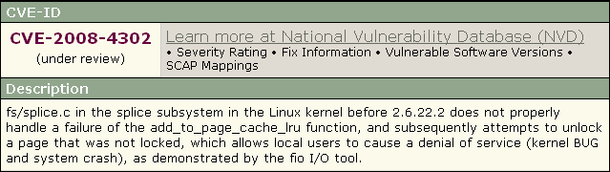

Real World Example – Improper Cleanup
If function hits an error, it fails to secure a page lock.
However, the fail code path attempts to call an unlock on a page that was not locked.
Bug in the kernel causes system DoS.

Slide 43
1 boolean DoStuff ()
2 {
3 try
4 {
5 while (condition == true)
6 {
7 ThreadLock(TRUE);
8 // do some stuff
9 // an exception may be thrown
10 ThreadLock(FALSE);
11 }
12 }
13 catch (Exception e)
14 {
15 System.err.println("Something bad happened!");
16 return (FAILURE);
17 }
18 return (SUCCESS);
19 }
If an exception is thrown while the thread is locked, then the function will return without unlocking the thread.

Slide 44
Secure Coding …
1 boolean DoStuff ()
2 {
3 try
4 {
5 while (condition == true)
6 {
7 ThreadLock(TRUE);
8 // do some stuff
9 // an exception may be thrown
10 ThreadLock(FALSE);
11 }
12 }
13 catch (Exception e)
14 {
15
16 if (isThreadLocked == TRUE) ThreadLock(FALSE);
17
18 System.err.println("Something bad happened!");
19 return (FAILURE);
20 }
21 return (SUCCESS);
22 }

